Slide 1
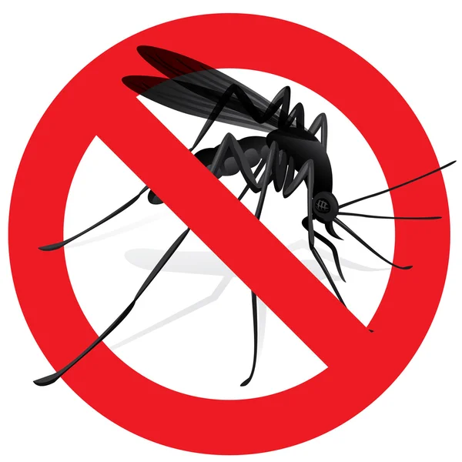

Plan4Demand
Provide impactful & effective solutions
Richelle-Joy Chia, Er Jie Yong, Meriky Lo
Notes:
As part of the Disease and Treatment Agency (Division of Societal Cures In Epidemiology and New Creative Engineering), we have been tasked to solve some big problems

Slide 2
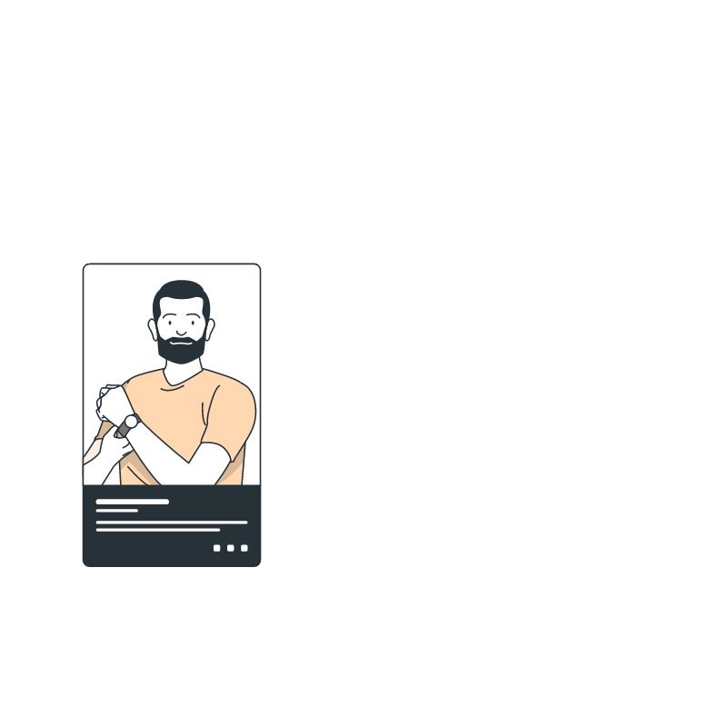
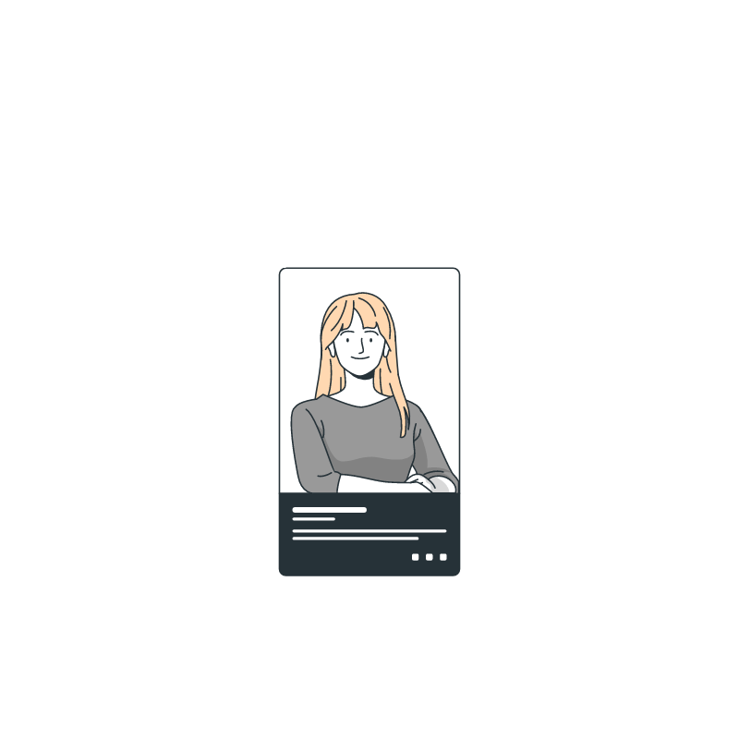




Our team
Richelle-Joy Chia
Er Jie Yong
Meriky Lo
Team Lead Officer (TLO)
Team Modeling Officer (TMO)
Team Financial Officer (TFO)
Notes:
As part of the Disease and Treatment Agency (Division of Societal Cures In Epidemiology and New Creative Engineering), our data team have been asked to fix some of the issues related to the WNV

Slide 3

Problem Statement
To help the City of Chicago Public Health Department optimize measures to tackle financial burdens caused by WNV related diseases
Notes:
As mentioned, we are here to help the City of Chicago Public Health Department optimize measures to tackle financial burdens caused by West Nile Virus related diseases.
Build a Machine Learning Model that predict outbreaks
Look at the optimal timeframe for pesticide spraying
Cost benefit analysis

Slide 4

Table of contents
01
04
Background
Modeling
02
05
Data Cleaning and EDA
Cost Benefit Analysis
03
06
Feature Engineering
Conclusion and Recommendations
Notes:
Data Cleaning & Modifications
Exploratory Data Analysis
Constraints & assumptions (numMosq, normal dist, weather station 1/2)
Feature Engineering
Modeling
Cost Benefit Analysis / Tableau
Conclusions derived
Next steps

Slide 5

01
Background

Slide 6


WNV history
1937
Mosquito-borne virus - Incurable 1 in 5 develop mild symptoms 1 in 150 develop severe symptoms
First identified in Uganda (Eastern Africa)
1999
2001
First discovered in New York (USA)
First detected in Chicago
Notes:
Currently, there are not medication for the virus, prevention is the only way to stop the virus

Slide 7

WNV history
2007-2014
2022
Still exists!
2005
2012
Started peaking in Chicago
Number of cases surpassed by this season
Notes:
But we decided to use the data between 2007-2014 since it was between the start of the peak to highest number of cases
Chicago is the most poulous city in the State of Illinois and the third most populous city in the US. As such, it is crucial to start taking effective actions to try to contain the massive spread among the public. The City of Chicago has been putting in place some intervention measures to contain the spread, one of which is to spray insecticides using aeroplanes and helicopters to treat large areas.

Slide 8


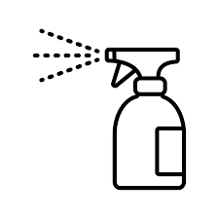
Our data
Train Test
Weather
Spray
2007 2009 2011 2013
2008 2010 2012 2014
2007-2014
2011 2013
Note: our train data set is imbalanced (95% virus absent, 5% virus present)

Slide 9
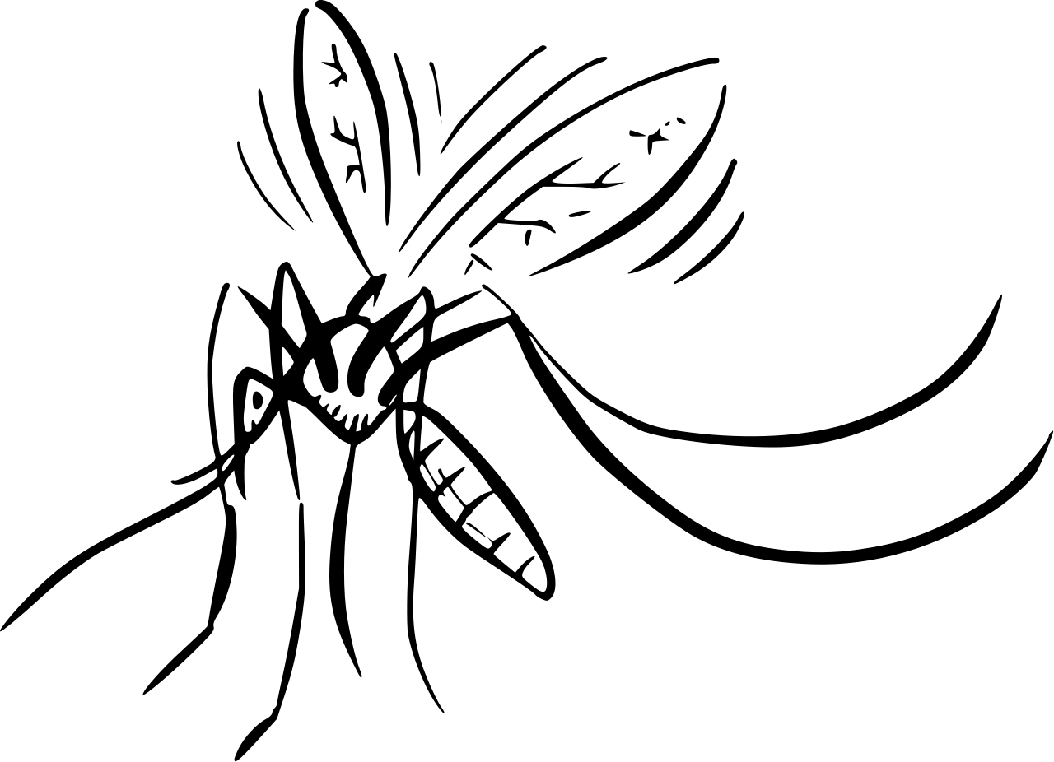

Understanding our subject
Life cycle of 8 - 10 days
Lay eggs in water
Culex mosquitoes have been known to fly up to 3.2 km
Temperature, Precipitation, Humidity and Wind correlates positively with predicting WNV
Notes:
https://www.cdc.gov/mosquitoes/about/life-cycles/culex.html
https://www.ncbi.nlm.nih.gov/pmc/articles/PMC4342965/

Slide 10

02
Data Cleaning and EDA

Slide 11
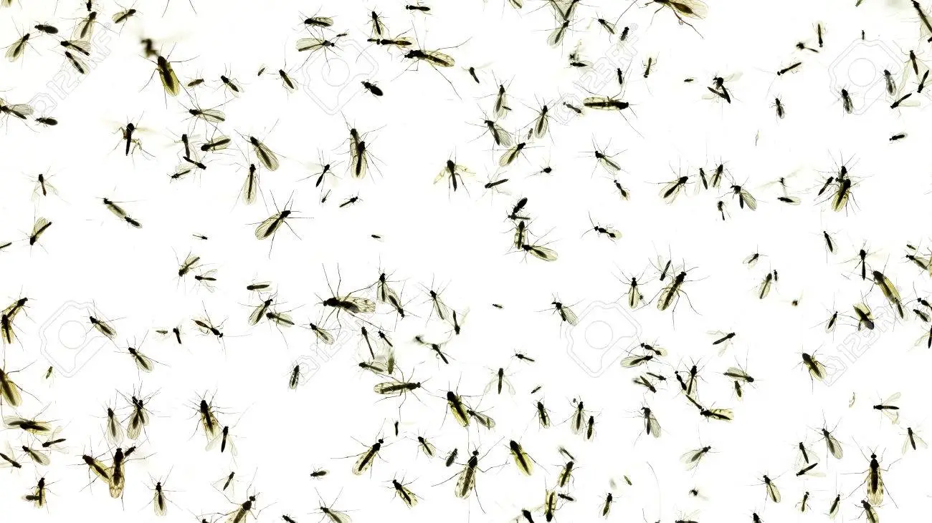


Data Cleaning
Merged rows with more than 50 mosquitos
Removed columns with more than 50% missing data
Impute means for those with lesser missing values
Notes:
Merged rows that have more than 50 mosquitos (created extra row)
Check for missing data (deleted columns with more than 50% missing data) eg: snowfall, water1. Impute mean for those with lesser missing values

Slide 12
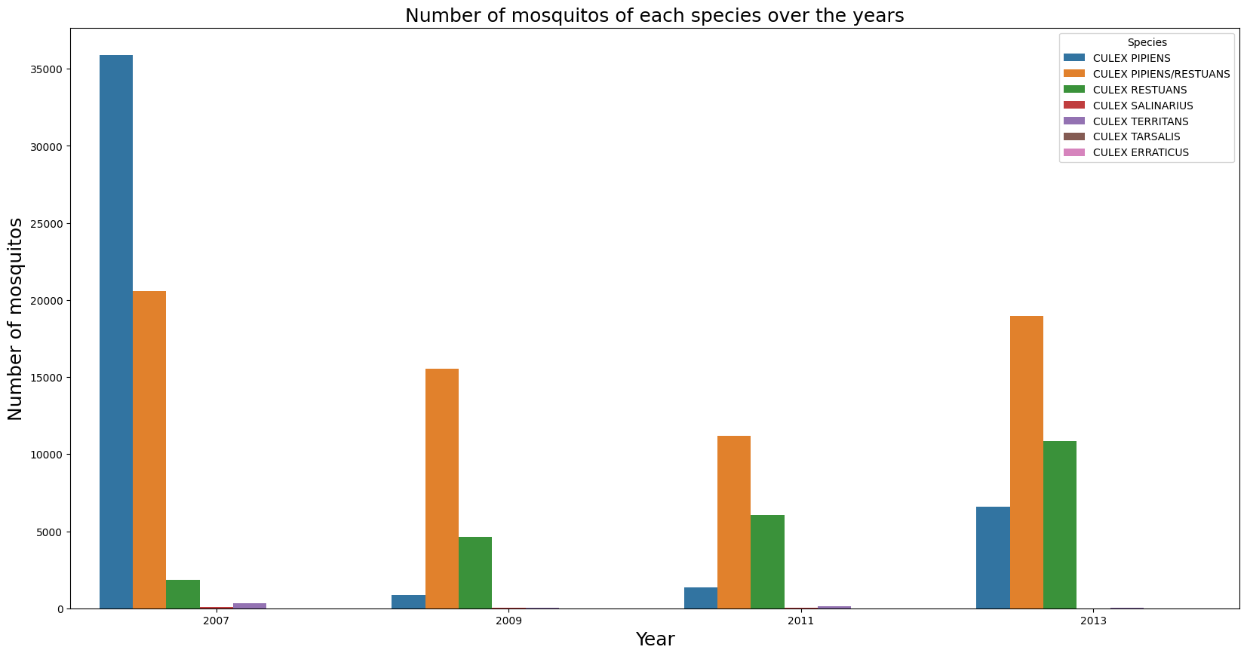
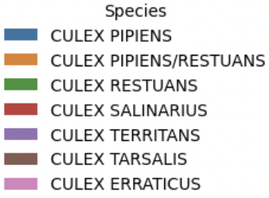
Number of mosquitoes
WNV Mosquito Species
Culex Pipiens/Restuans | 262
Culex Pipiens | 240
Culex Restuans | 49
Notes:
Here, we examined the number of mosquitos per year and per species and found that not all mosquitos species carry WNV. These are the species that carry WNV: Culex Pipiens/Restauns, Culex Pipiens, and Culex Restauns.

Slide 13
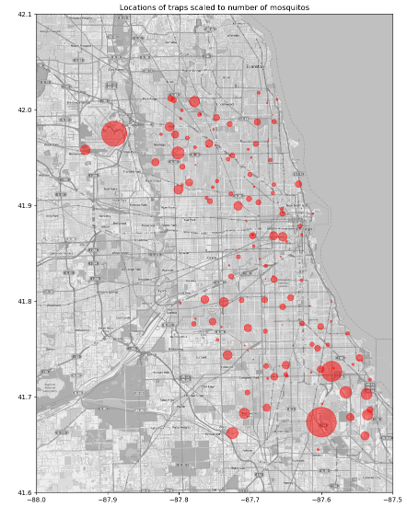
Location of traps scaled to number of mosquitoes
Notes:
The bigger the circle, the higher the number of mosquitoes

Slide 14
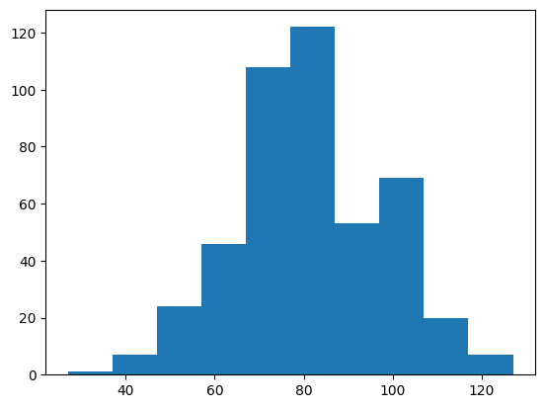
Number of traps with WNV detected
Number of traps with WNV
Number of days
Notes:
Number of traps with WNV detected according to number of days
We did a check to ensure that number of traps with mosquitos having WNV roughly follow a normal distribution.

Slide 15
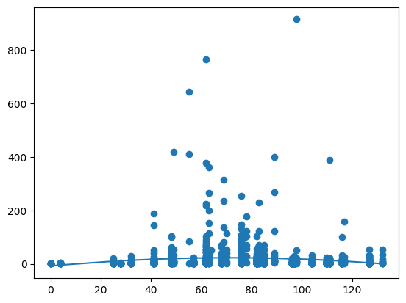
Number of mosquitoes created for test data
Number of Mosquitoes
Note: an unsuccessful attempt due to other unforeseen outbreaks
Number of days
Notes:
We attempt to derive number of mosquitoes based on date for test data
But here we can see that the number of mosquitoes do follow the normal distribution but there are random outbreaks. This could be due to outbreak of mosquitoes that year.
Since we do not know when outbreaks happen during the test years, we will not proceed further to attempt to estiamte the number of mosquitos. We will drop number of mosquitos as part of the x variables when classifying WnvPresent

Slide 16
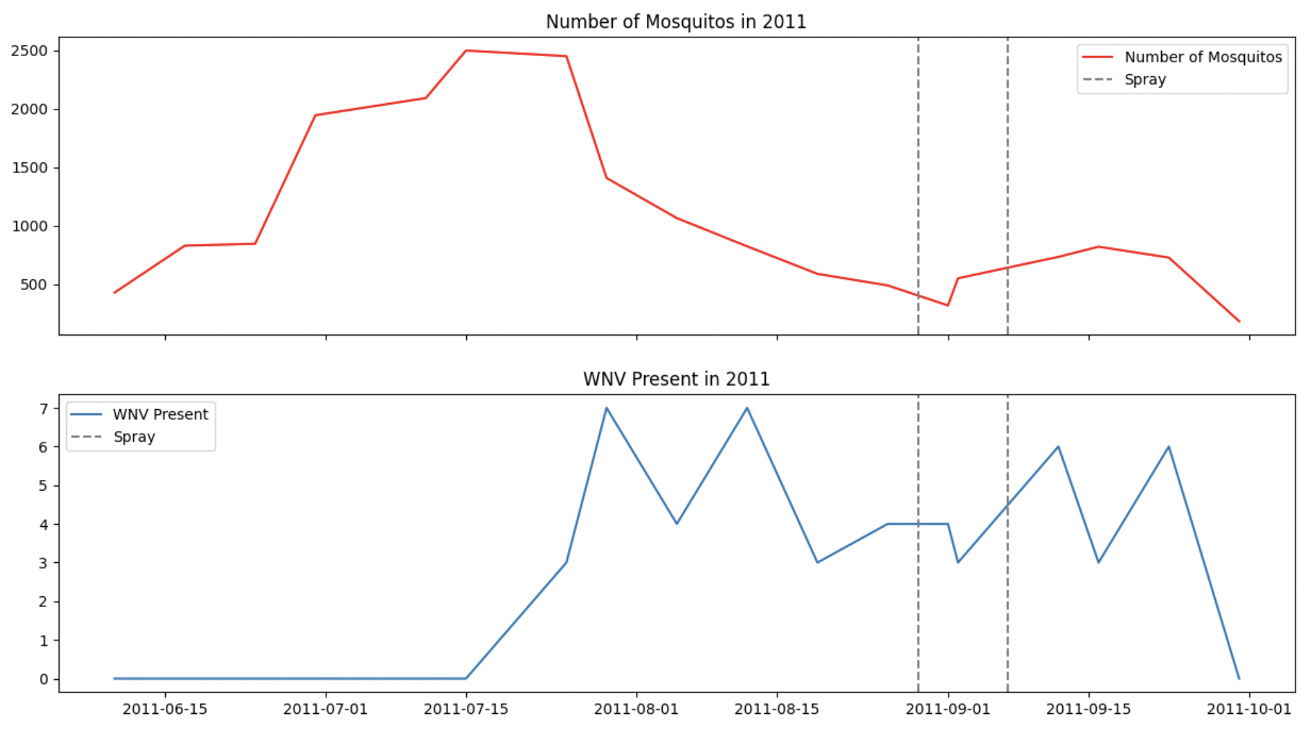
Is the spray helpful in 2011?

Slide 17
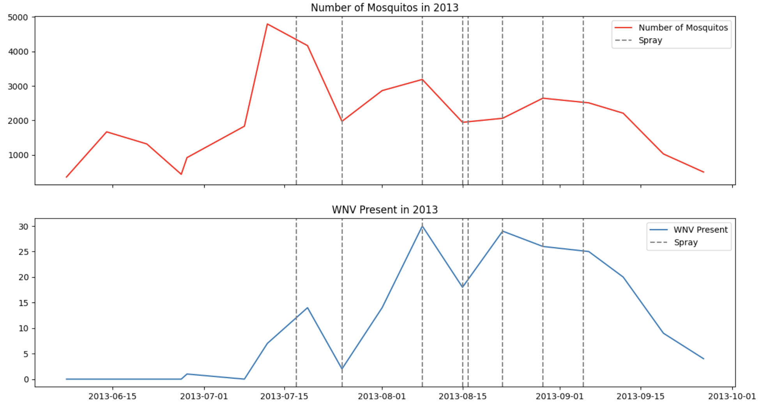
Is the spray helpful in 2013?
Notes:
To conclude, not very useful, but we will come back to this again later

Slide 18

03
Feature Engineering

Slide 19

Feature Engineering
WetDry
Days since June 1
Binary Classification based on codesum
Cumulative count since start of data set (June 1)
Humidity
Trap Matrix
Derived from temperature & Dewpoint
Weighted matrix of traps within 3km
Trap Sprayed
Identify traps being sprayed within 300 ft and up to 30 days
Normal PDF
Weather Rolling Avg
Approximate PDF of WNV per year based on normal distribution
9 days rolling average of weather data

Slide 20

04
Modeling

Slide 21

Modeling
Base parameters
•Fix Imbalance
•Remove multicollinearity
•Polynomial Features

Slide 22


Modeling
•Standard Scaler
•Feature Selection
Create Cluster
2nd weighted classification
Spatial Network
Trap Matrix
•PowerTransformer
•Feature Selection
Remove Outliers
•Standard Scaler
•PCA
Tune & Ensemble
Remove Polynomial
•PowerTransformer
•PCA

Slide 23
Results
Hyperparameter | Best Model | Train/Test Accuracy | Train/Test AUC | Private Score | Public Score
•Standard Scaler •Feature Selection | Linear Discriminant Analysis | 0.6863 | 0.7508 | 0.67711 | 0.70093
•PowerTransformer •Feature Selection | Logistic Regression | 0.6944 | 0.7614 | 0.69228 | 0.71435
•Standard Scaler •PCA | Linear Discriminant Analysis | 0.6681 | 0.7456 | 0.65416 | 0.67500
•PowerTransformer •PCA | Linear Discriminant Analysis | 0.6544 | 0.7704 | 0.67743 | 0.69191
•No polynomial feat •Tune/Ensemble | Logistic Regression | 0.6795 | 0.7908 | 0.70854 | 0.72452
•Weighted •Tune/Ensemble | Logistic Regression | 0.7218 | 0.9305 | 0.70935 | 0.72172

Slide 24


Important Features
01
02
03
Based on model using feature_selection instead of PCA (black box)
Traps (T071, T138, T082)
Species Type
Week, Month
Notes:
Normal PDF Lat, Long multi_Wetbulb

Slide 25

05
Cost Benefit Analysis
Notes:
The goal is to optimise cost of pesticide spraying.

Slide 26
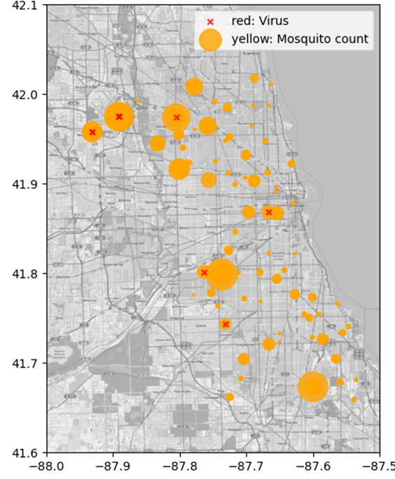
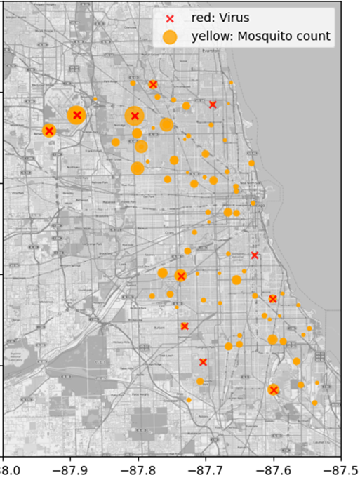
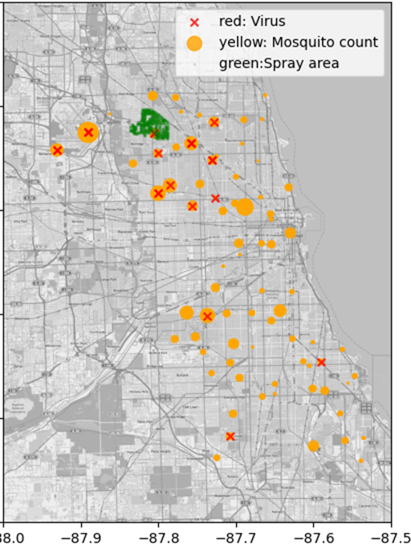
Mosquito count, WNV Presence, Spray 2011
JULY
AUGUST
SEPTEMBER

Slide 27
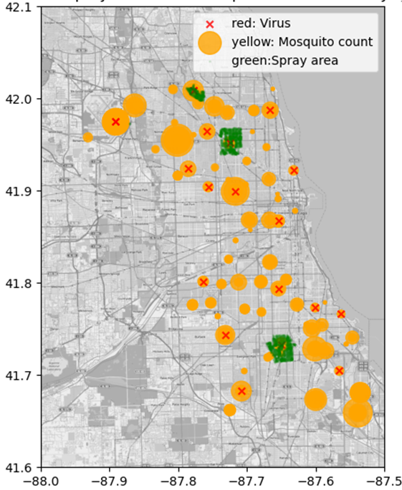
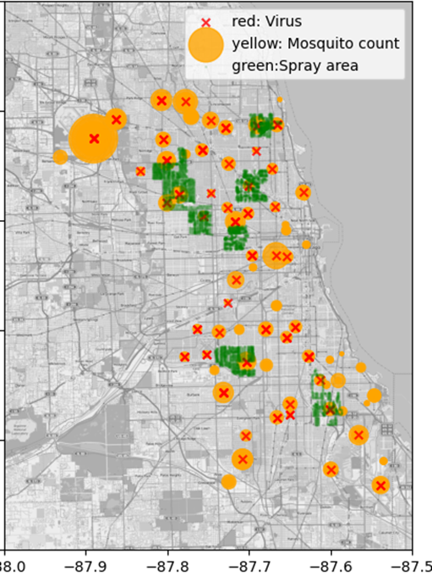
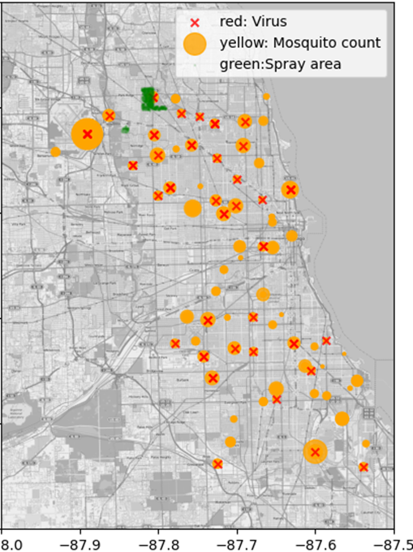
Mosquito count, WNV Presence, Spray 2013
JULY
AUGUST
SEPTEMBER
Notes:
The above plots show that spraying typically took place in August and September, while West Nile virus outbreaks start in June and July. This means that spraying does not help much to prevent west nile virus outbreaks when it peaks in the summer months. Ineffective preventions can result in high cases of west nile virus related diseases which in turn increase costs of medical treatments and lost of productivity.

Slide 28

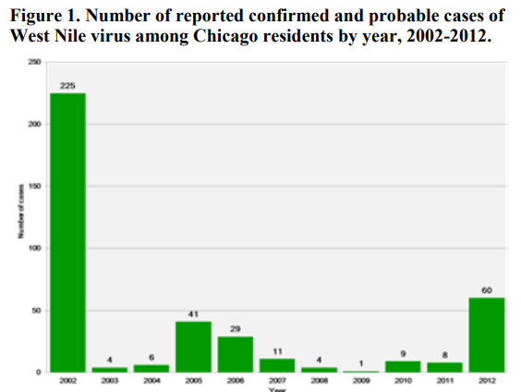

Public health
Economic burden
ISSUES
Notes:
* Ref: National Library of Medicine

Slide 29
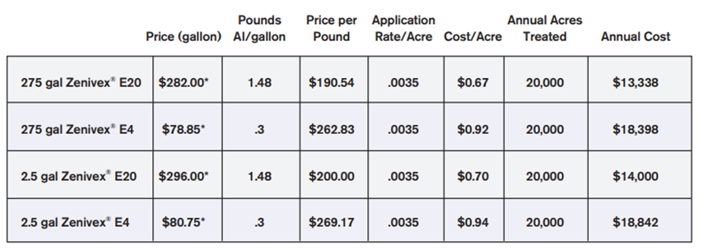
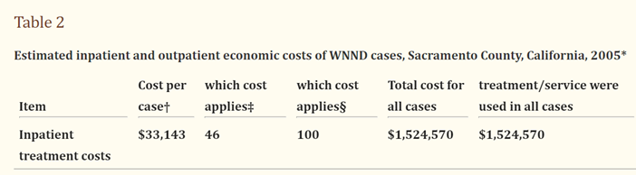
All Spray
Chicago City Area (acres) | 150,000
Pesticide cost per acre | $0.92
Total cost per month | $138,000
Assuming 3 sprays/year (Jul, Aug, Sep) | $414,000
Mean number of cases in Chicago over 10 years | 17
Mean medical cost per case | $33,143
Total mean medical cost per year | $563,431
BENEFIT: $149, 431 (26.5%)

Slide 30
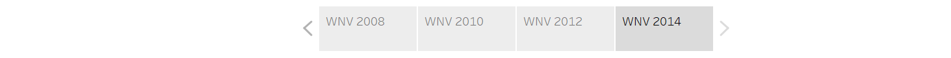
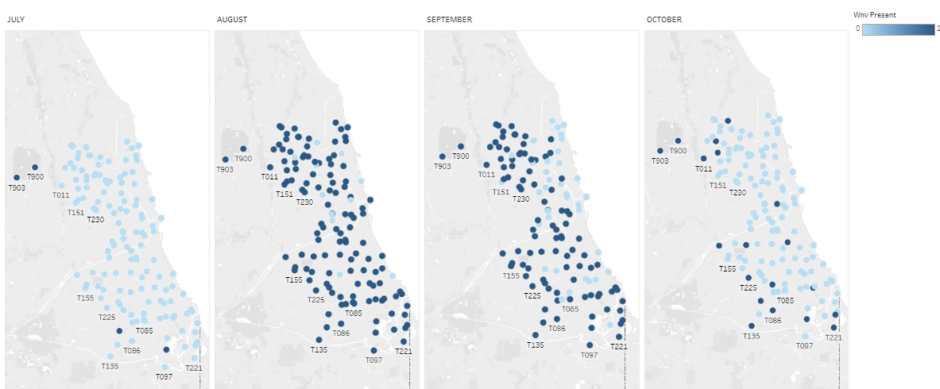
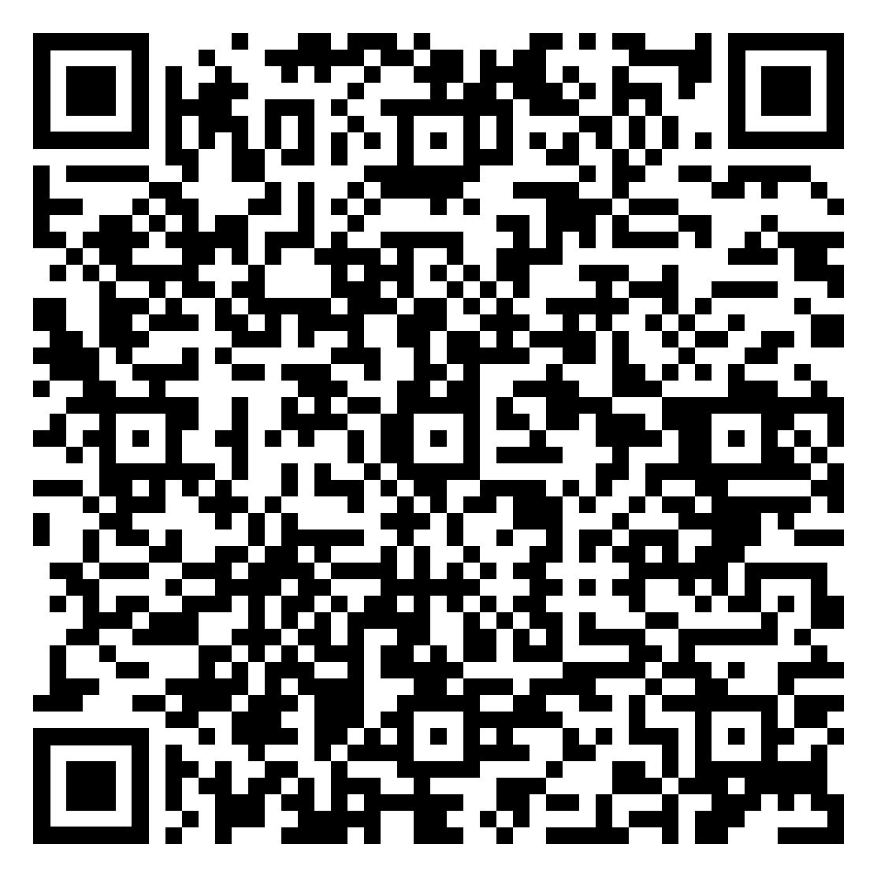
WNV Prediction 2014

Slide 31
Targeted Spray
MONTH 2014 | PREDICTED NO OF TRAPS WITH VIRUS | COST PER MONTH (number of traps x (acre/trap) x (cost/acre))
JULY | 4 | 4 x 1119 x $0.92 = | $ 4,118
AUGUST | 123 | 123 x 1119 x $0.92 = | $ 126,626
SEPTEMBER | 97 | 97 x 1119 x $0.92 = | $ 99,860
OCTOBER | 19 | 19 x 1119 x $0.92 = | $ 19,560
TOTAL COST PER YEAR: | $ 250,164
BENEFIT: $313,267 (55.6%)

Slide 32

All Spray vs Targeted Spray
 | All Spray | Targeted Spray*
Total mean medical cost per year | $563,431 | $563,431
Total Spray Cost per year | $414,000 | $250,164
BENEFIT | $149,431 (26.5%) | $313,267 (55.6%)
*Assumption that our model is 100% accurate at predicted trap with virus

Slide 33
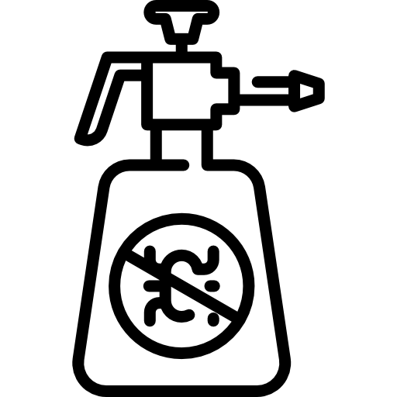


Limitations
Other costs involved in spraying
Pesticide is 100% effective
Costs arising from lost of productivity due to serious illness/deaths
No price for human’s health/life

Slide 34

06
Conclusion
& Recommendations

Slide 35

Conclusion
Most important features
Location and date
Observations from past data
Current spraying is not optimum in reducing number of mosquitoes/virus

Slide 36

Recommendations
Targeted spray
Specific dates and locations based on our model predictions
Identify
Look for more effective pesticides
Preventive measures
Spraying on high risk areas, public education

Slide 37

Next steps
Predict outbreaks timeframe and location
Predict number of mosquitoes
More feature engineering/EDA to identify higher correlated features

Slide 38

Thank You !

